Slide 1
The following experiments are to be implemented in ‘C’ language:
(i) Simple Chat Program using TCP Sockets

Slide 2
GENERAL INSTRUCTIONS
Document
Right hand side
Aim Algorithm
Program
Result
Left hand side
Sample IO
Figures (if any)
Evaluation will be based on
Submission date, clarity in documentation.

Slide 3
Socket
How does a program communicate with another program over a network?

Slide 4
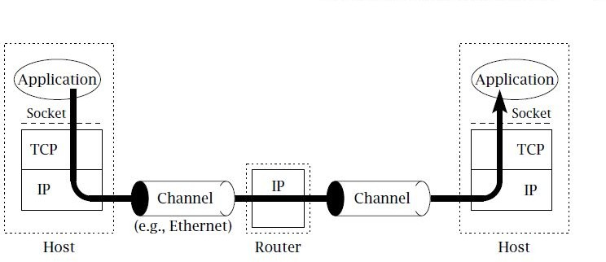
A TCP/IP Network

Slide 5
???
Main protocols used in TCP/IP model?
Where is TCP, UDP and IP protocols implemented?

Slide 6
Network layer
Network layer deals with the problem of forwarding packets towards the destination.
Datagram services – every packet is handled and delivered by the network independently.
Protocol – IP ( Internet Protocol)
IP packet must contain the address of destination

Slide 7
Transport Layer
Choice between two protocols
TCP
UDP
Builds on the services provided by IP
TCP and UDP address – port numbers
Port numbers – identify applications within the hosts.

Slide 8
Addressing
Address - Byte string that identifies a node.
Network can use a node’s address to distinguish it from the other nodes connected to the network.
Types of Addressing
Physical
Logical
Port

Slide 9
Physical Address
A link-layer address is variously called a LAN address, a physical address, or a MAC
address
MAC address is 6 bytes long, giving 2⁴⁸ possible MAC addresses
Expressed in hexadecimal notation, with each byte of the address expressed as a pair of
hexadecimal numbers.
MAC addresses were designed to be permanent- MAC address has a flat structure and doesn’t
change no matter where the adapter is. analogous to a person’s social security number.
IEEE manages the MAC address space
IEEE allocates the chunk of 2²⁴ addresses by fixing the first 24 bits of a MAC address and
letting the company
create unique combinations of the last 24 bits for each adapter.
Example MAC Address:
49-BD-D2-C7-56-2A

Slide 10
Logical Address
In the Internet, the host is identified by its IP address.
an IP address is a 32-bit(four bytes) quantity that we can uniquely identifying the host.
In an IP address, each period separates one of the bytes expressed in decimal notation
from 0 to 255.
An IP address is hierarchical because as we scan the address from left to right, we
obtain more and more specific information about where the host is located in the
Internet (ie, within which network, in the network of networks)
host’s IP addresses needs to be changed when the host moves, i.e, changes the network
to which it is attached.
An IP address is analogous to a person’s postal address
Example IP Address:
222.222.222.220

Slide 11
Port Number
Message sending process must identify the receiving process running in the host because in general, a host
could be running many network applications.
This is done by Port Number
Port Number is a 16 bit number.
Types:
System Ports/Well Known Ports - 0 to 1023 (assigned by IANA)
User Ports/Registered Ports - 1024 to 49151 (assigned by IANA)
Dynamic Ports/Private or Ephemeral Ports – 49152 to 65535 (never assigned)
Eg:
Web server is identified by port number 80.
A mail-server process is identified by port number 25.

Slide 12
Who assigns the IP addresses and port numbers?
Internet Assigned Numbers Authority (IANA)
https://www.iana.org

Slide 13
Client & Server
Client and Server – refer to roles
The client program initiates communication
The server program waits passively for and then responds to clients that contacts it.
Whether a program is acting as a client or server determines the general form of its use of the sockets API to establish communication with its peer.

Slide 14
Sockets
Applications access the services provided by UDP and TCP through the sockets API.
A socket is an abstraction through which an application may send and receive data
Information written to the socket by an application on one machine can be read by an application on a different machine and vice versa.

Slide 15
Sockets
The main types of sockets in TCP/IP
stream sockets
datagram sockets.
Stream sockets use TCP as the end-to-end protocol (with IP underneath) and thus provide a reliable byte-stream service.
Datagram sockets use UDP (with IP underneath) and thus provide a best-effort datagram service that applications can use to send individual messages up to about 65,500 bytes in length.
A TCP/IP socket is uniquely identified by an Internet address, an end-to-end protocol (TCP or UDP), and a port number.

Slide 16
Byte Ordering Functions
Consider a 16-bit integer that is made up of 2 bytes. There are two ways to store the two bytes in memory:
little-endian byte order - with the low-order byte at the starting address.
big-endian byte order - with the high-order byte at the starting address.
Byte ordering used by a given system is referred as host byte order
Network programmers must deal with these byte ordering because networking protocols must specify a network byte order.
The sending protocol stack and the receiving protocol stack must agree on the order in which the bytes of these multi byte fields will be transmitted.
IP use big-endian byte ordering for multi byte integers.

Slide 17
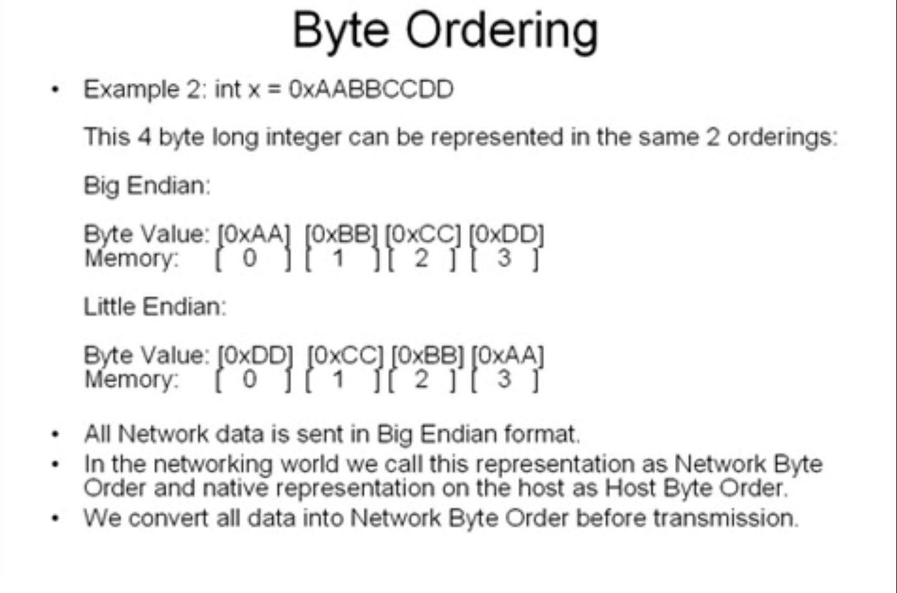

Slide 18
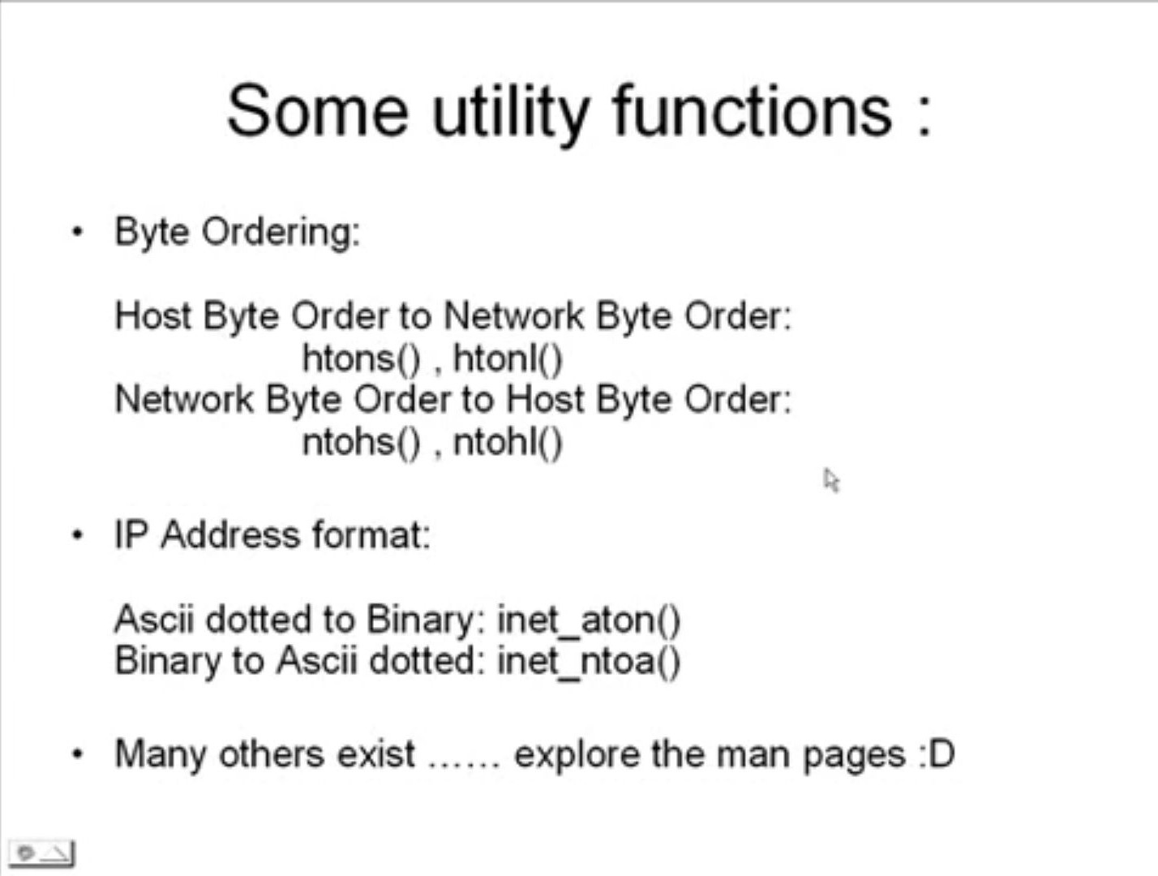

Slide 19
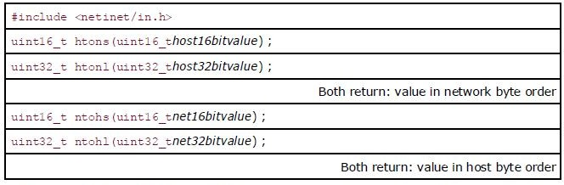
Byte ordering functions
In a TCP segment, there is a 16-bit port number and a 32-bit IPv4 address.

Slide 20
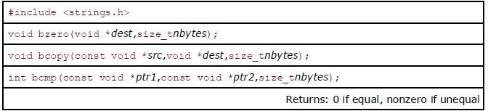
Byte Manipulation Functions
We need these types of functions when dealing with socket address structures because we need to manipulate fields such as IP addresses, which can contain bytes of 0, but are not C character strings.

Slide 21
Byte Manipulation Functions
bzero sets the specified number of bytes to 0 in the destination. Often use this function to initialize a socket address structure to 0.
bcopy moves the specified number of bytes from the source to the destination.
bcmp compares two arbitrary byte strings. The return value is zero if the two byte strings are identical; otherwise, it is nonzero.

Slide 22
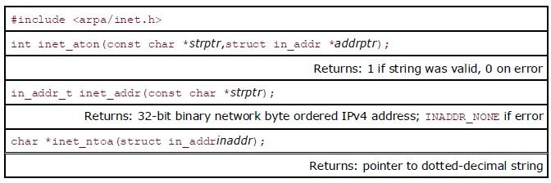
inet_aton(), inet_addr(), inet_ntoa()
They convert Internet addresses between ASCII strings (what humans prefer to use) and network byte ordered binary values (values that are stored in socket address structures).
inet_aton, inet_ntoa, and inet_addr convert an IPv4 address from a
dotted-decimal string (e.g., "206.168.112.96") to its 32-bit network byte ordered binary value.

Slide 23
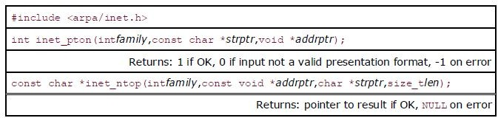
inet_pton() and inet_ntop()
These two functions are new with IPv6 and work with both IPv4 and IPv6 addresses. The letters "p" and "n" stand for presentation and numeric.
The presentation format for an address is often an ASCII string and the numeric format is the binary value that goes into a socket address structure.

Slide 24
inet_pton() and inet_ntop()
The first function tries to convert the string pointed to by strptr, storing the binary result through the pointer addrptr. If successful, the return value is 1. If the input string is not a valid presentation format for the specified family, 0 is returned.
inet_ntop does the reverse conversion, from numeric (addrptr) to presentation (strptr). The len argument is the size of the destination, to prevent the function from overflowing the caller's buffer.

Slide 25
TCP Socket

Slide 26
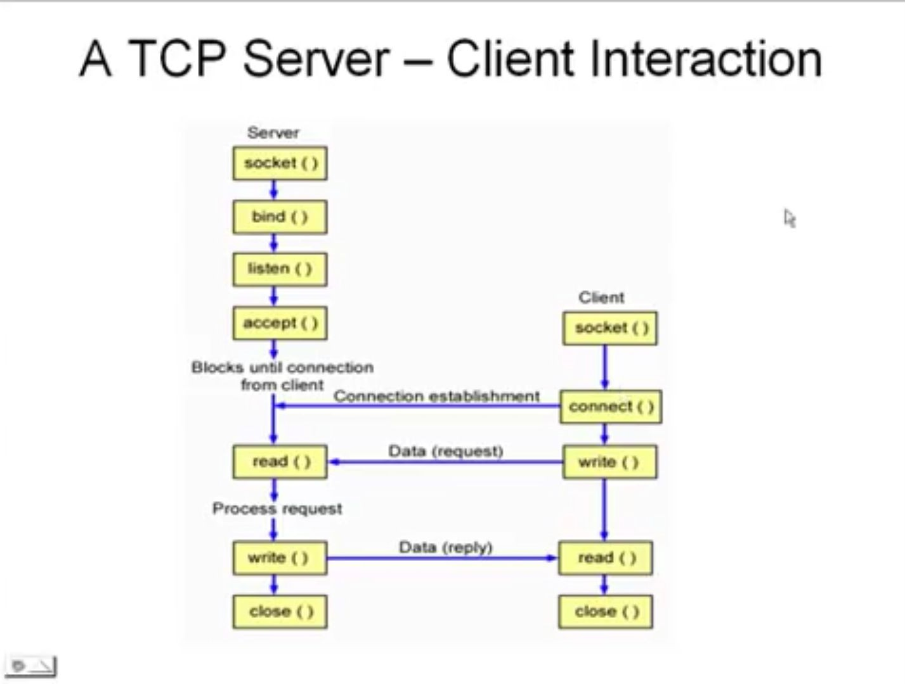

Slide 27


Slide 28
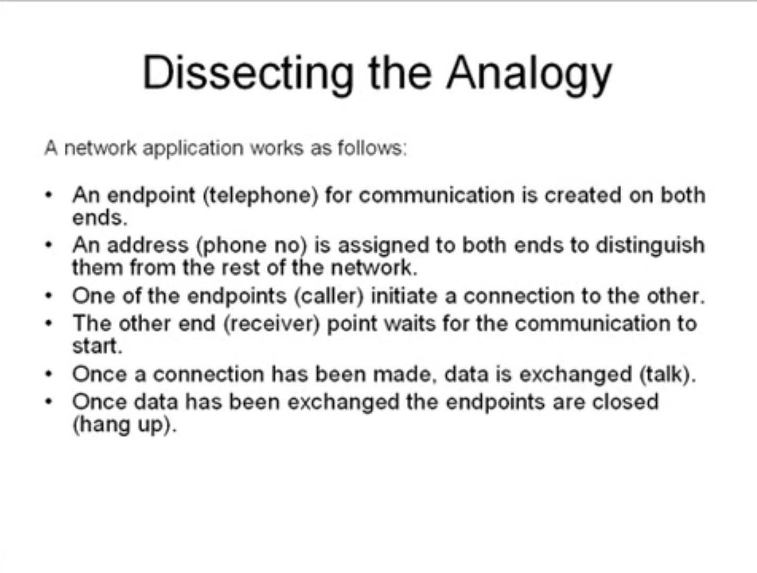

Slide 29
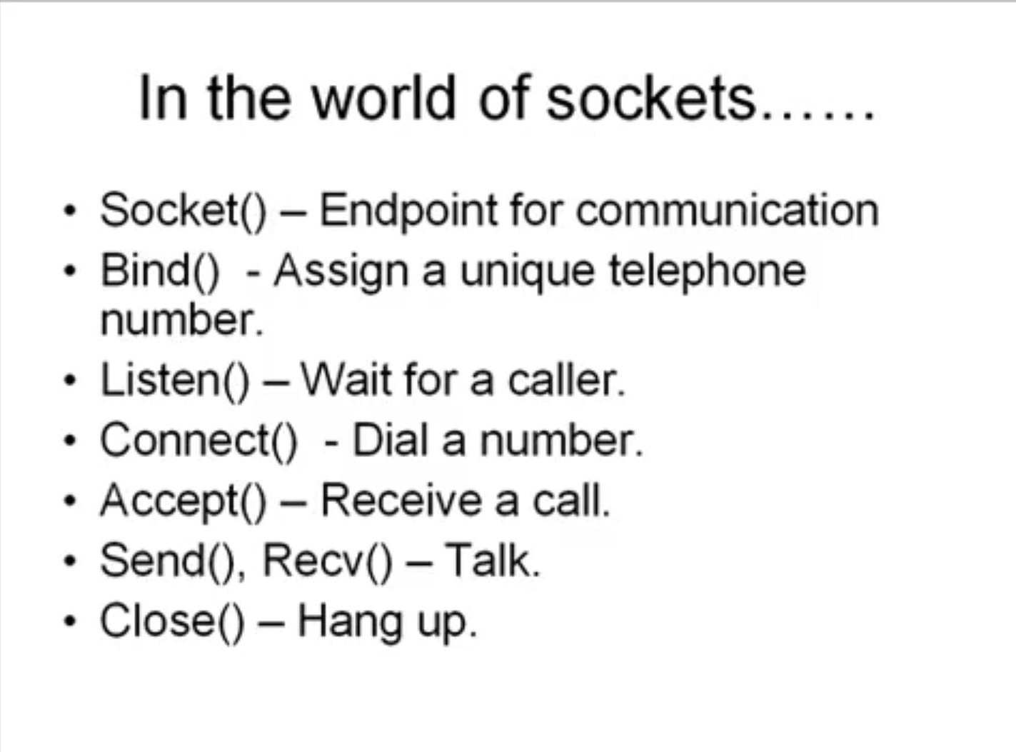

Slide 30
IPv4 Socket Address Structure
Most socket functions require a pointer to a socket address structure as an argument.
Each supported protocol suite defines its own socket address structure.
The names of these structures begin with sockaddr_ and end with a unique suffix for each protocol suite.
An IPv4 socket address structure, commonly called an "Internet socket address structure," is named sockaddr_in and is defined by including the
<netinet/in.h> header.

Slide 31
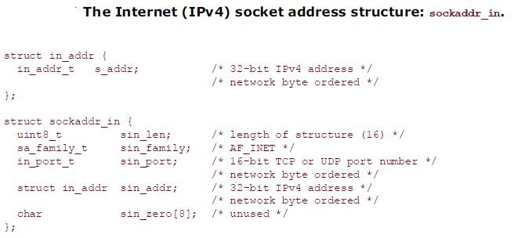
POSIX Definition:

Slide 32
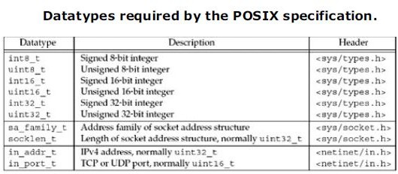

Slide 33
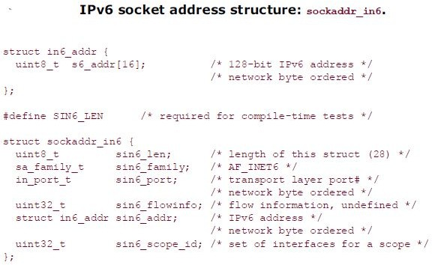

Slide 34

Socket ()
To perform network I/O, the first thing a process must do is call the socket function, specifying the type of communication protocol desired.
protocol of 0 selects the system's default for the given combination of family and
type.
On success, the socket function returns a small non-negative integer value, called
socket descriptor, or a sockfd.

Slide 35
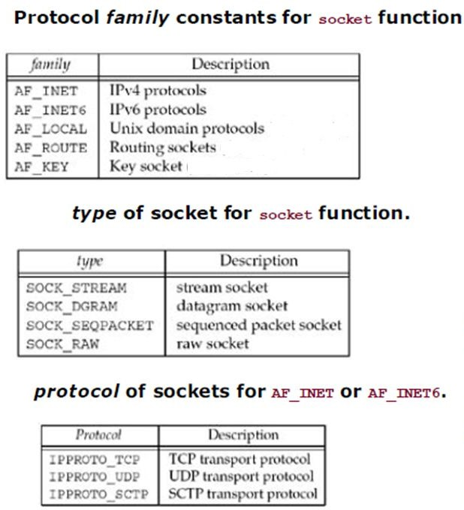
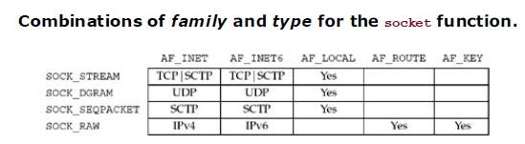
Not all combinations of socket family and type are valid.
The AF_ prefix stands for “address family” and the PF_ stands for “protocol family”

Slide 36
int sockdc;
sockdc = (AF_INET,STREAM_SOCK,0);
if(sockdc ==-1)
{
printf(“Error in socket”); exit(1);
}

Slide 37

Bind()
The bind function assigns a local protocol address to a socket.
With the Internet protocols, the protocol address is the combination of either a 32-bit IPv4 address or a 128-bit IPv6 address, along with a 16-bit TCP or UDP port number.
The second argument is a pointer to a protocol-specific address, and the third argument is the size of this address structure.

Slide 38
int bindsa
Struct sockaddr_in serv;
bzero(&serv,sizeof(serv))
serv.sin_family=AF_INET;
Serv.sin_port=htons(PORT);
Serv.sin_addr.s_addr=htonl(“”);
bindsa = bind(sockfd,(struct sockaddr*)&serv,sizeof(serv));
If(bindsa == -1)
{
print(“error in binding”);
exit(1);
}

Slide 39
Bind()
A process can bind a specific IP address to its socket. The IP address must belong to an interface on the host.
Normally a TCP client does not bind an IP address to its socket. The kernel chooses the source IP address when the socket is connected, based on the outgoing interface that is used, which in turn is based on the route required to reach the server

Slide 40
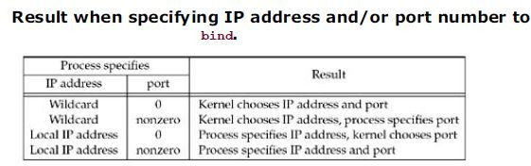
If we specify a port number of 0, the kernel chooses an ephemeral port when bind is called.
But if we specify a wildcard IP address, the kernel does not choose the local IP address until the socket is connected (TCP) or a datagram is sent on the socket (UDP).
With IPv4, the wildcard address is specified by the constant INADDR_ANY, whose value is normally 0. This tells the kernel to choose the IP address.

Slide 41

Bind()
For IPv4
For IPv6

Slide 42
Listen()
The listen function is called only by a TCP server and it performs following actions:
When a socket is created by the socket function, it is assumed to be an active socket, that is, a client socket that will issue a connect.
The listen function converts an unconnected socket into a passive socket, indicating that the kernel should accept incoming connection requests directed to this socket.
second argument to this function specifies the maximum number of connections the kernel should queue for this socket.

Slide 43

Listen()
This function is normally called after both the socket and bind functions and must be called before calling the accept function.
Backlog defines the maximum length the queue of pending connections may grow to.
Do not specify a backlog of 0, as different implementations interpret this differently.
If you do not want any clients connecting to your listening socket, close the listening socket.
Many current systems allow the administrator to modify the maximum value for the backlog.

Slide 44
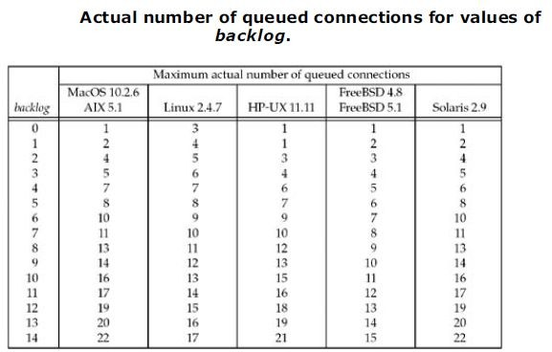
Listen()

Slide 45
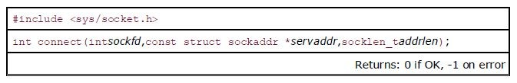
Connect ()
The connect function is used by a TCP client to establish a connection with a TCP server.
sockfd is a socket descriptor returned by the socket function.
The second and third arguments are a pointer to a socket address structure and its size.
The socket address structure must contain the IP address and port number of the server.
In the case of a TCP socket, the connect function initiates TCP's three-way handshake

Slide 46
#define PORT 8080
int connectrt;
struct sockaddr_in serv;
bzero(&serv,sizeof(serv))
serv.sin_family=AF_INET;
Serv.sin_port=htons(PORT);
Serv.sin_addr.s_addr=htonl(“”);
connectrt = (sockfd, (struct sockaddr*) &serv,sizeof(serv));
If(connectrt ==-1)
{
Print( “Error in connection”);
exit(1);
}

Slide 47
Accept()
If accept is successful, its return value is a brand-new descriptor automatically created by the kernel. This new descriptor refers to the TCP connection with the client.
A given server normally creates only one listening socket, which then exists for the lifetime of the server.
The kernel creates one connected socket for each client connection that is accepted (i.e., for which the TCP three-way handshake completes).
When the server is finished serving a given client, the connection socket is closed.

Slide 48
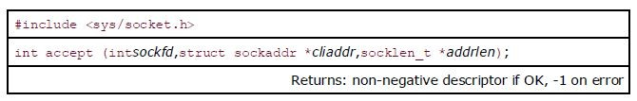
Accept()
It is called by a TCP server to return the next completed connection from the front of the completed connection queue.
If the completed connection queue is empty, the process is put to sleep (assuming the default of a blocking socket).
cliaddr and addrlen arguments are used to return the protocol address of the connected peer process (the client).
addrlen is a value-result argument

Slide 49
Accept()
This function returns up to three values:
an integer return code that is either a new socket descriptor or an error indication,
the protocol address of the client process (through the cliaddr pointer),
the size of this address (through the addrlen pointer).
If we are not interested in having the protocol address of the client returned, we set both cliaddr and addrlen to null pointers.

Slide 50
Int acceptr;
Struct sockaddr_in cli; socklen_t len; len=sizeof(cli);
acceptr =accept(sockfd,(struct sockaddr*) &cli,&len);
If(acceptr==-1)
{}

Slide 51
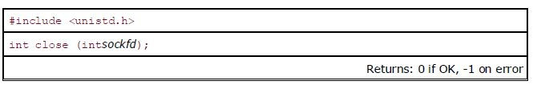
Close()
The normal Unix close function is also used to close a socket and terminate a TCP connection.
The default action of close with a TCP socket is to mark the socket as closed and return to the process immediately.
The socket descriptor is no longer usable by the process: It cannot be used as an argument to read or write.
TCP will try to send any data that is already queued to be sent to the other end, and after this occurs, the normal TCP connection termination sequence takes place.

Slide 52

Write()
The write function attempts to write nbyte bytes from the buffer pointed by buf to the file associated with the open file descriptor, fildes.
fildes − It is a socket descriptor returned by the socket function.
buf − It is a pointer to the data you want to send.
nbyte − It is the number of bytes to be written. If nbyte is 0, write() will return 0 and have no other results if the file is a regular file; otherwise, the results are unspecified
Upon successful completion, write() returns the number of bytes actually written to the file associated with fildes. This number is never greater than nbyte. Otherwise, -1 is returned.
You can also use send() function to send data to another process.

Slide 53

Read()
The read function attempts to read nbyte bytes from the file associated with the buffer, fildes, into the buffer pointed to by buf.
fildes − It is a socket descriptor returned by the socket function.
buf − It is the buffer to read the information into.
nbyte − It is the number of bytes to read
You can also use recv() function to read data to another process.

